Slide 1
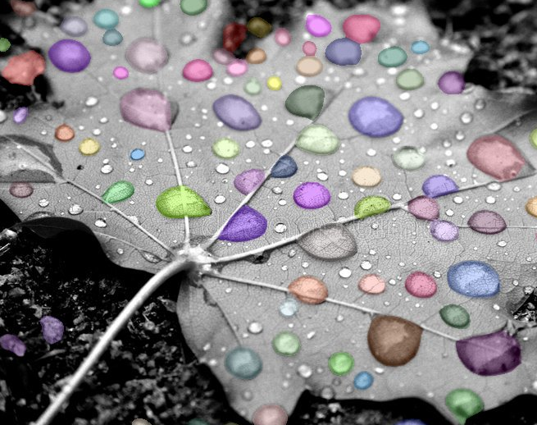
New Image Analysis Resources at The Rockefeller University
Speaker: Ved Sharma, Ph.D.
Image Analyst
Bio-Imaging Resource Center, The Rockefeller University
Email: vsharma01@rockefeller.edu
Date: Wednesday, April 6th, 2022
Seminar time: 10:00am – 11:00am
Workshop time: 11:00am – 12:30pm
Place: A Level Training/Classroom, Welch Hall, The Rockefeller University
Bio-Imaging Resource Center, The Rockefeller University

Slide 2
Seminar slides and workshop material will be made available on our GitHub page:
https://github.com/ImageAnalysis-RockefellerUniversity
Bio-Imaging Resource Center, The Rockefeller University

Slide 3
Outline
Open-source Softwares
ImageJ/Fiji, QuPath, Napari, CellProfiler, Icy
Commercial Softwares
Imaris, Arivis, Aivia, Huygens, MetaMorph
Machine/Deep Learning frameworks
Weka, ilastik, Labkit
StarDist, Cellpose, DeepImageJ, ZeroCostDL4Mic
Segmentation
Cell/particle Counting and Tracking
Image denoising
Bio-Imaging Resource Center, The Rockefeller University

Slide 4
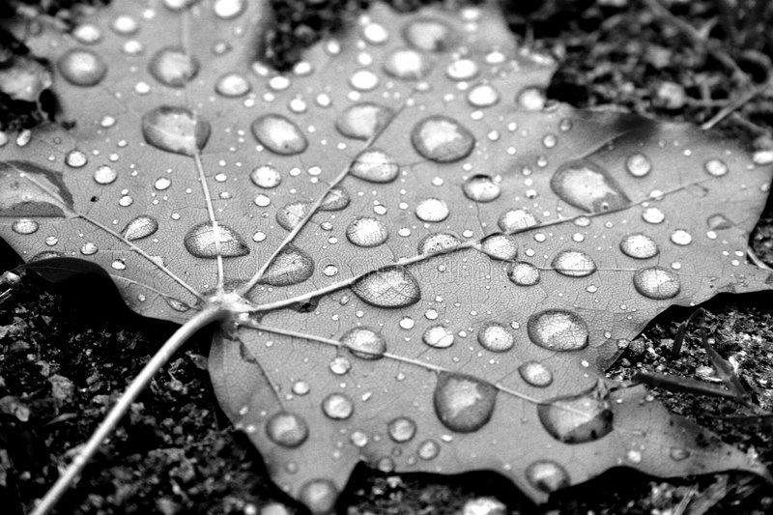
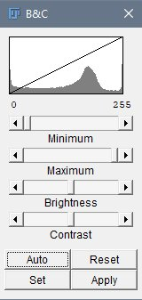
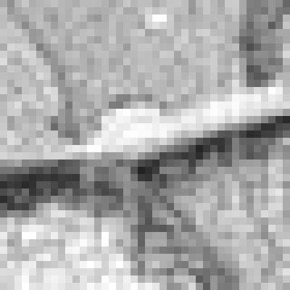
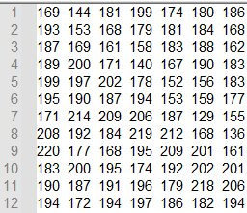
What is a Raster Image?
Raster images are composed of a grid of pixels
Each pixel contains intensity information
Number of bits (N) determine the range of intensity levels
Image Type | Range of intensity levels (0 to 2^{N}-1)
8-bit | 0 - 255
12-bit | 0 - 4095
16-bit | 0 - 65,535
RGB color (3 x 8 bits) | 0 - 255 per channel
8-bit image (256 shades)
Histogram
Image as a matrix of numbers (0-255)
Bio-Imaging Resource Center, The Rockefeller University
Notes:
bit-depth, Compression, File formats, Bio-Formats plugin

Slide 5
Segmentation
Identifying object(s) of interest in an image
cells, nuclei, membrane, transcription sites etc.
Segmentation is usually followed by quantitative analysis of object(s)
number of cells/nuclei, mean fluorescence intensity, shape etc.
Divide image into areas representing object(s) of interest and background
Segmentation is not an easy task to solve in most practical cases
Signal variability throughout the image
Noise, blur and other distortions caused by the imperfect imaging conditions
Bio-Imaging Resource Center, The Rockefeller University

Slide 6
Segmentation tools
Global thresholding, local thresholding
Image processing filters – Gaussian, Median, Sobel etc.
Machine learning methods (supervised learning) - Weka, Labkit, ilastik
Deep Learning methods - StarDist, Cellpose
3D segmentation - Imaris, Arivis
Bio-Imaging Resource Center, The Rockefeller University

Slide 7
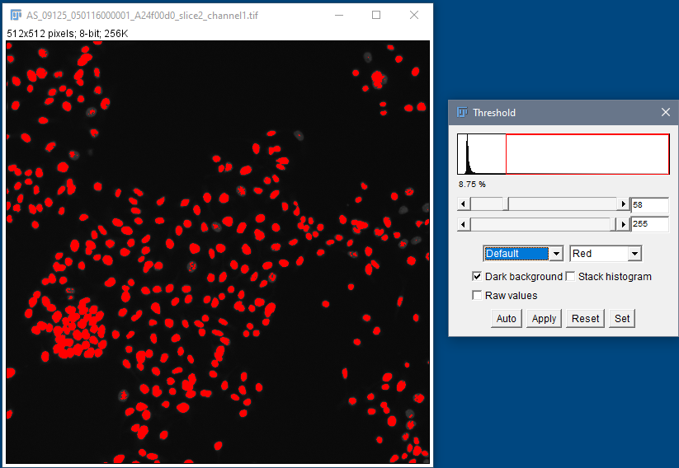
Segmentation using global thresholding
Nuclei stained with Hoechst
Threshold 1
Human HT29 colon cancer cells, Image from Broad Bioimage Benchmark Collection, Ljosa et al. 2012 Nat Methods
Bio-Imaging Resource Center, The Rockefeller University

Slide 8
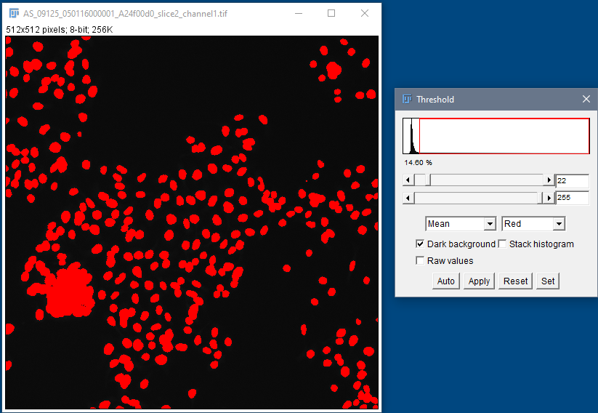
Segmentation using global thresholding
Nuclei stained with Hoechst
Threshold 2
Human HT29 colon cancer cells, Image from Broad Bioimage Benchmark Collection, Ljosa et al. 2012 Nat Methods
Bio-Imaging Resource Center, The Rockefeller University

Slide 9
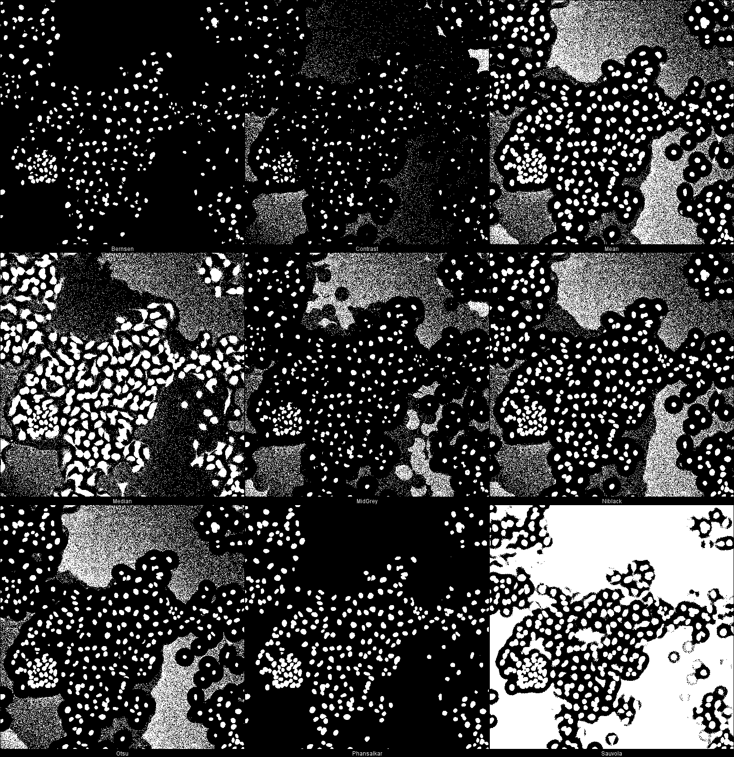
Segmentation with local thresholding
Nuclei stained with Hoechst
Auto Local Threshold in Fiji
Human HT29 colon cancer cells, Image from Broad Bioimage Benchmark Collection, Ljosa et al. 2012 Nat Methods
Bio-Imaging Resource Center, The Rockefeller University

Slide 10
Segmentation using Machine Learning
Supervised learning - pixel classification using Random Forest classifier
Fiji (Weka and Labkit plugins), ilastik, QuPath, Napari, CellProfiler
Requires orders of magnitude less training data/resources than Deep Learning methods
Bio-Imaging Resource Center, The Rockefeller University

Slide 11
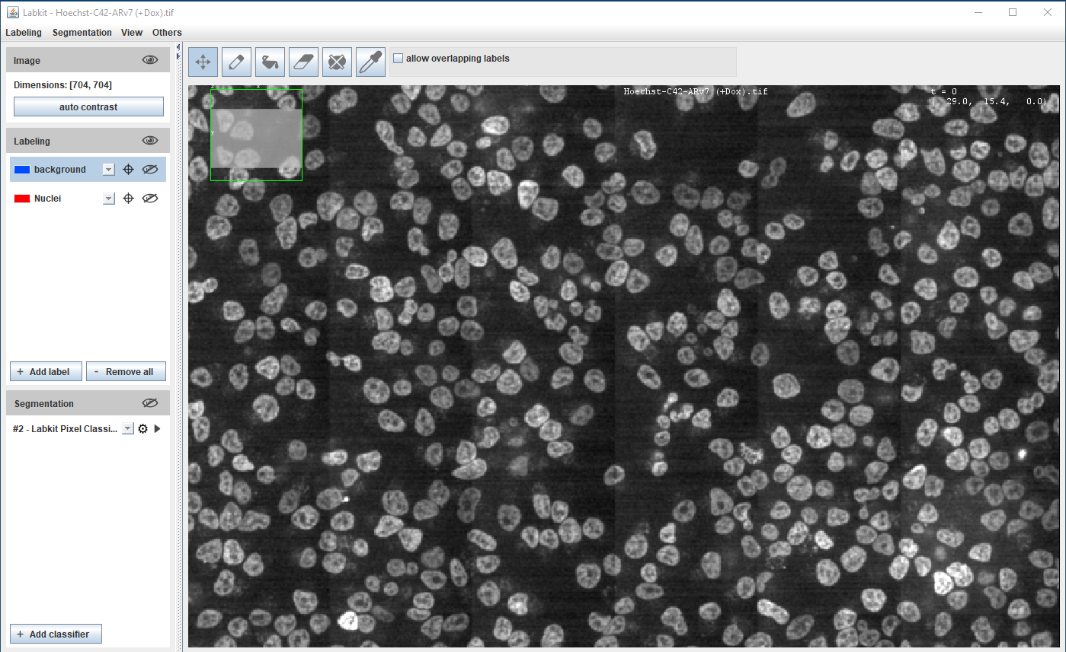
Hoechst-stained Nuclei, image courtesy of Cherie Au, Giannakakou Lab, Weill Cornell Medicine
Bio-Imaging Resource Center, The Rockefeller University

Slide 12
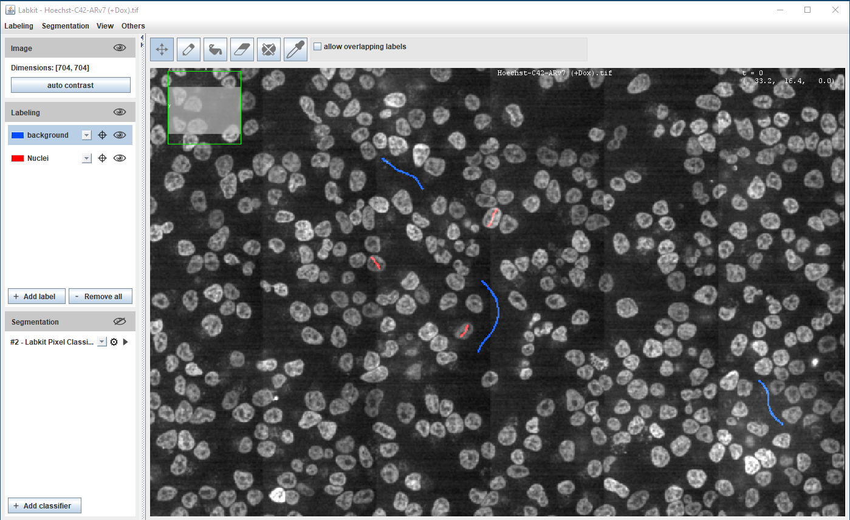
Hoechst-stained Nuclei, image courtesy of Cherie Au, Giannakakou Lab, Weill Cornell Medicine
Bio-Imaging Resource Center, The Rockefeller University

Slide 13
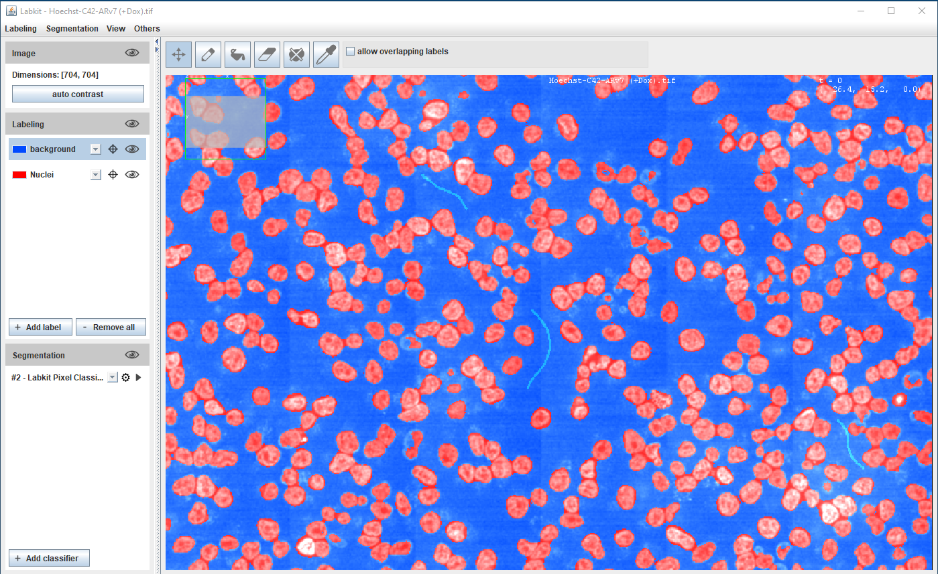
Hoechst-stained Nuclei, image courtesy of Cherie Au, Giannakakou Lab, Weill Cornell Medicine
Bio-Imaging Resource Center, The Rockefeller University

Slide 14
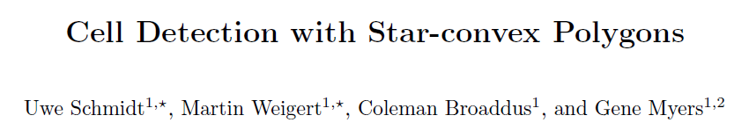
Segmentation using Deep Learning
Most accurate methods available for cells/nuclei segmentation
StarDist (2018)
Step 1: Training
Generating a Deep Learning model is resource hungry:
High-end workstation
Large amounts of training data (images and annotations)
Training could take hours to days
Good programming knowledge required - Python
arXiv:1806.03535
Cellpose (2021)
Step 2: Prediction
Using the model from step 1 to predict the segmentation results :
A regular laptop is just fine
Prediction takes seconds to mins
Little to no programming knowledge required
Bio-Imaging Resource Center, The Rockefeller University

Slide 15
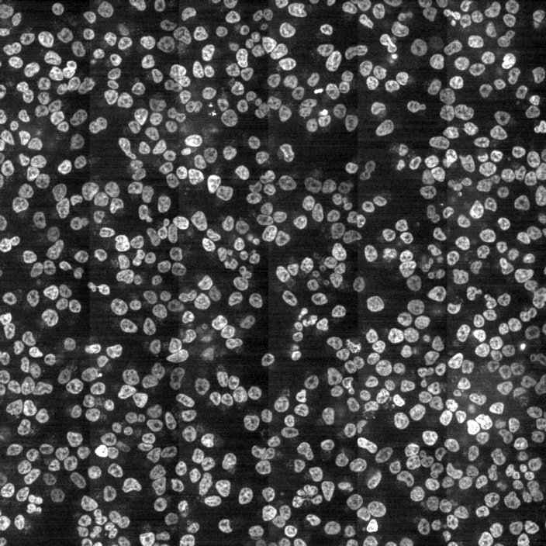
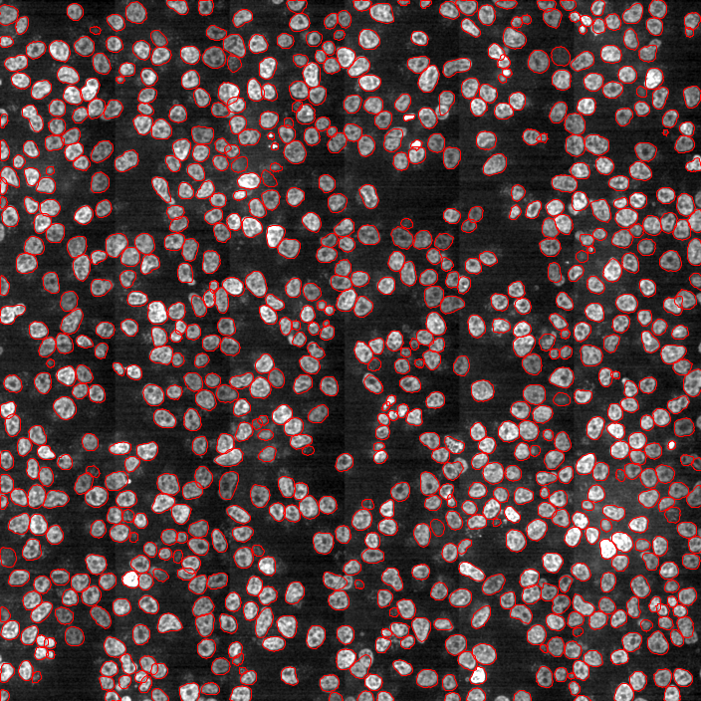
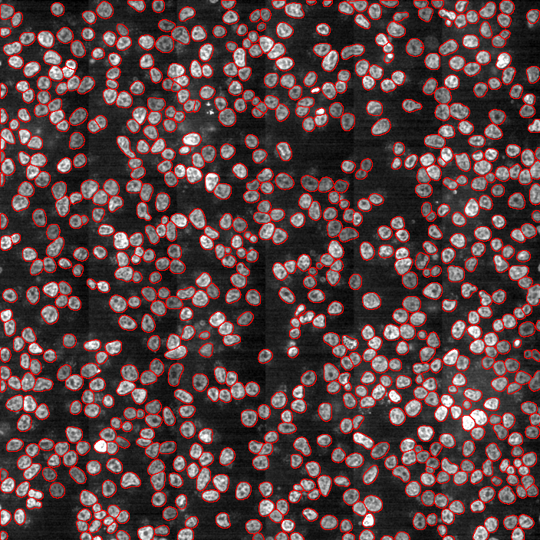
Segmentation using Deep Learning
Original
StarDist plugin in Fiji
Cellpose
Hoechst-stained Nuclei, image courtesy of Cherie Au, Giannakakou Lab, Weill Cornell Medicine
Workshop Exercise 1: StarDist based nuclear segmenation in a challenging image in Fiji
Bio-Imaging Resource Center, The Rockefeller University

Slide 16
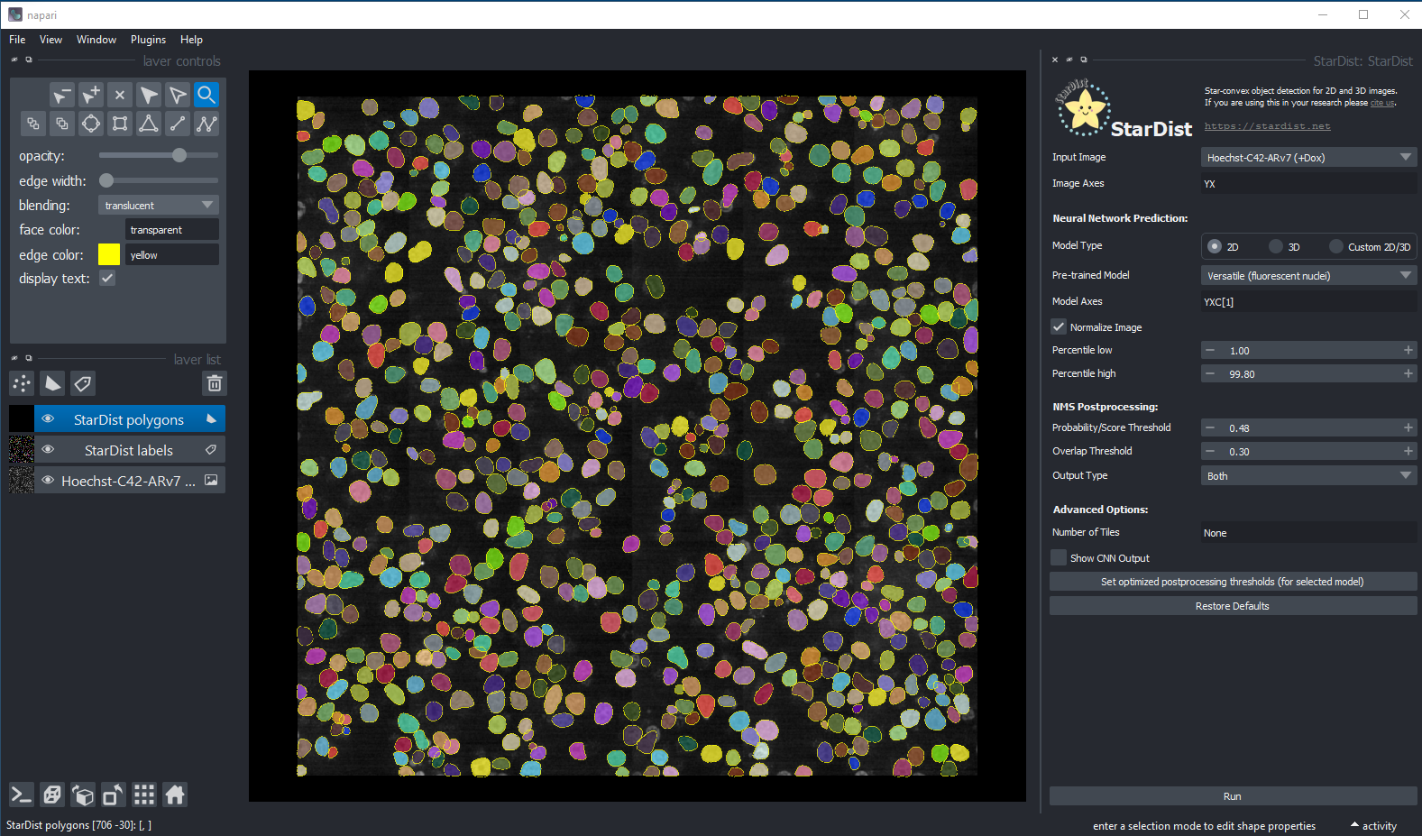
Segmentation using StarDist in Napari
Bio-Imaging Resource Center, The Rockefeller University

Slide 17
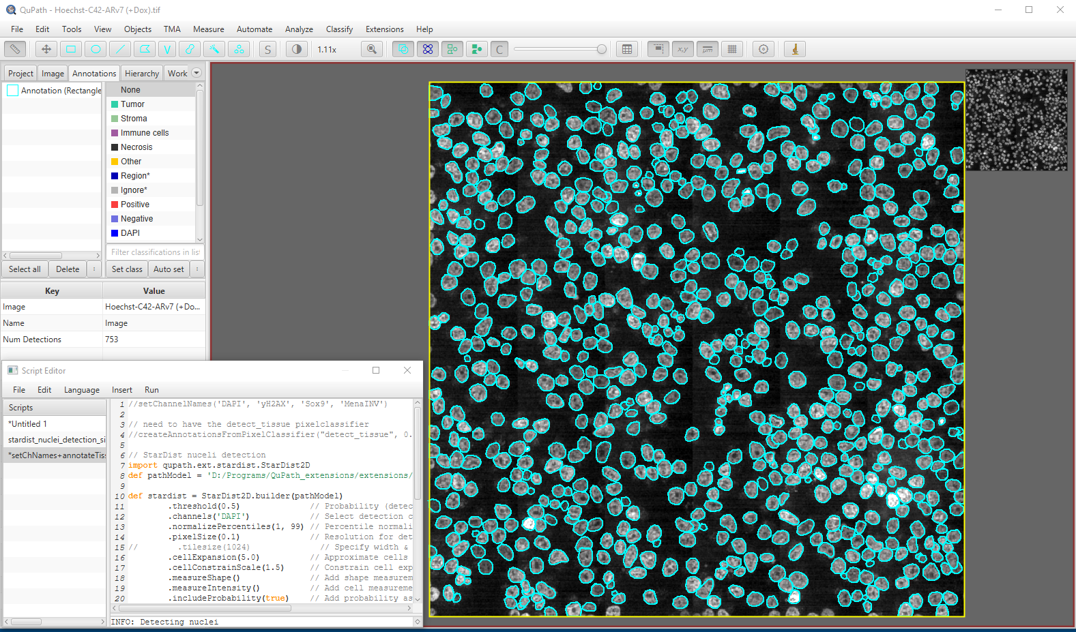
Segmentation using StarDist in QuPath
Bio-Imaging Resource Center, The Rockefeller University

Slide 18
Segmentation – comparison of Deep Learning models
Bio-Imaging Resource Center, The Rockefeller University
Notes:
Bacterial cells - Escherichia coli

Slide 19
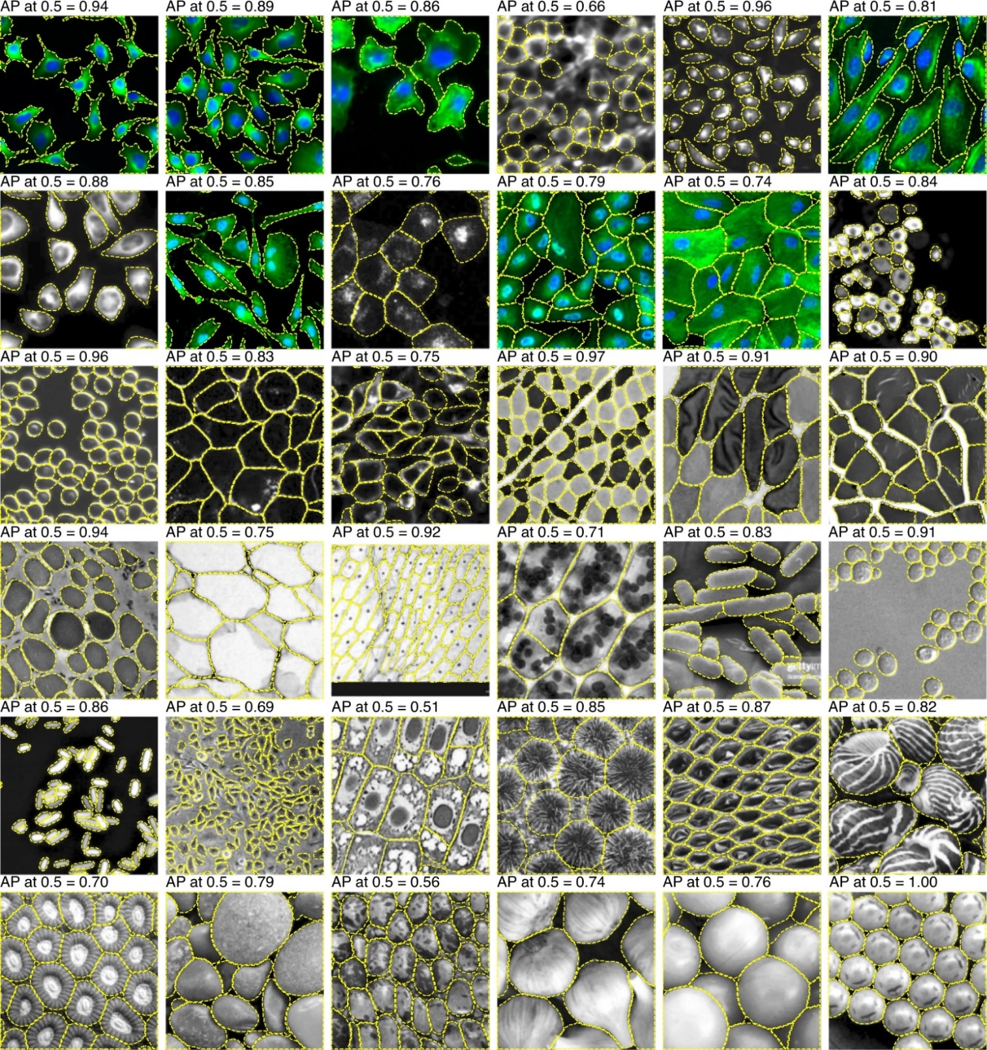
Cellpose
Stringer et al 2021, Nat Methods
Bio-Imaging Resource Center, The Rockefeller University
Notes:
Bacterial cells - Escherichia coli

Slide 20
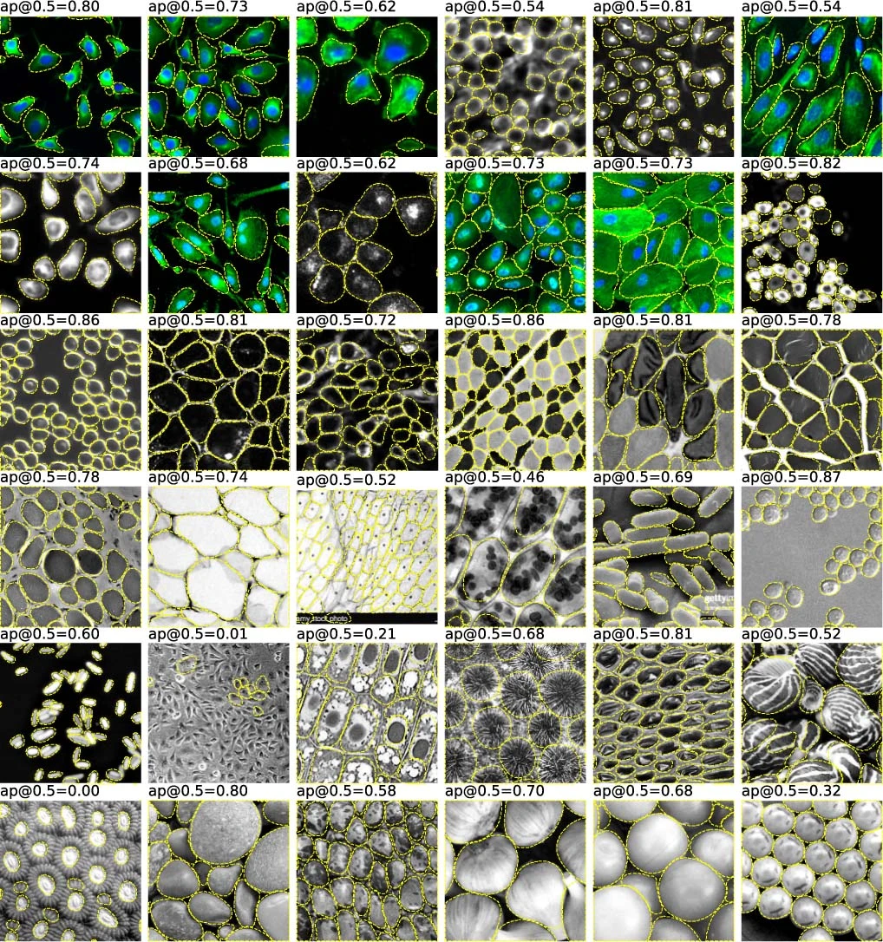
StarDist
Stringer et al 2021, Nat Methods
Bio-Imaging Resource Center, The Rockefeller University

Slide 21
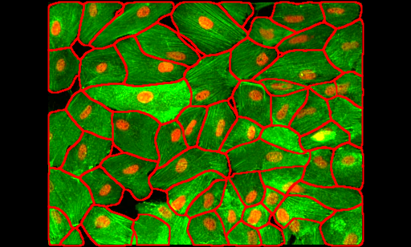
Segmentation – challenging cases
Crowded fluorescent cells
Cellpose segmentation
Image from https://github.com/MouseLand/cellpose
Bio-Imaging Resource Center, The Rockefeller University

Slide 22
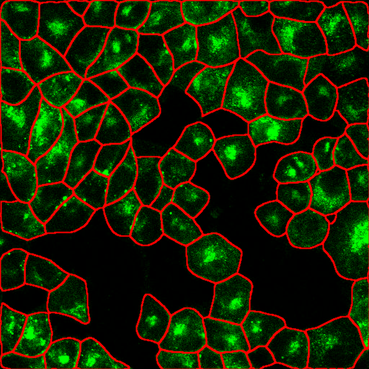
Segmentation – challenging cases
Crowded cells, noisy signal
Cellpose segmentation
Image from https://github.com/MouseLand/cellpose
Bio-Imaging Resource Center, The Rockefeller University

Slide 23
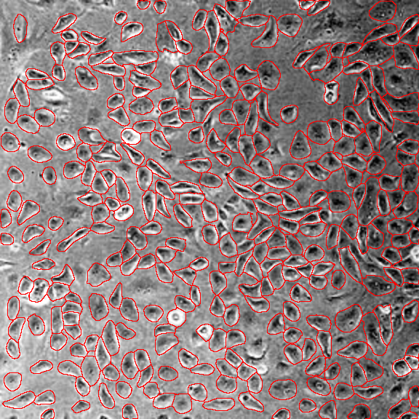
Segmentation – challenging cases
Crowded cells, uneven illumination
Cellpose segmentation
Image from https://github.com/MouseLand/cellpose
Bio-Imaging Resource Center, The Rockefeller University

Slide 24
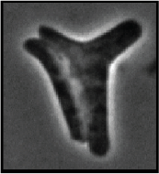
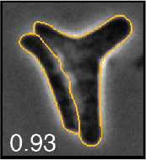
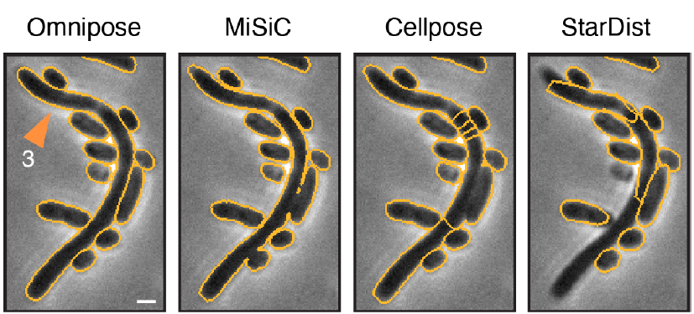
Segmentation – comparison of Deep Learning models
Phase contrast image
StarDist
Cellpose
Bacteria - Escherichia coli
Cutler et al. bioRxiv 2021
Bio-Imaging Resource Center, The Rockefeller University

Slide 25

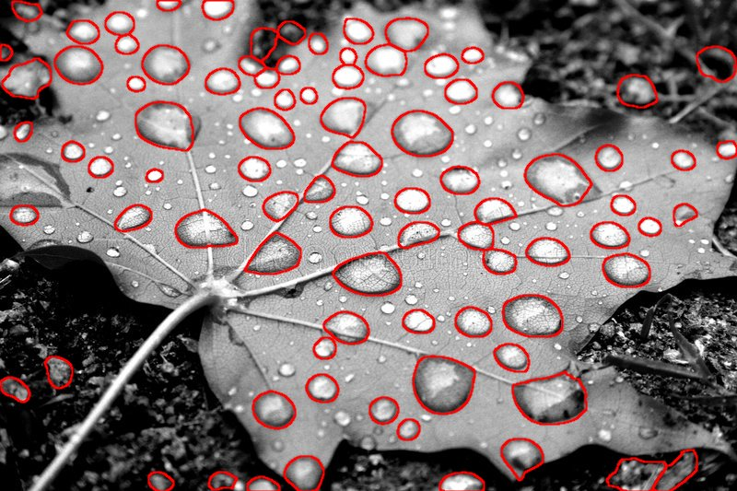
Segmentation – take home message
There is no single “BEST” segmentation method
Try different approaches to see which one works “BEST” for your “SPECIFIC” images
Denoising Filtering Masking Segmentation
Original image
Cellpose segmentation
Bio-Imaging Resource Center, The Rockefeller University

Slide 26
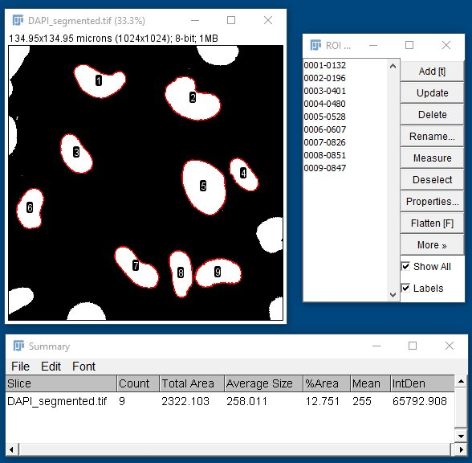
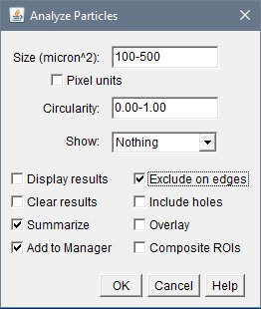
Cell/particle counting in Fiji
DAPI
segmented binary image
Image courtesy of Uwe Schaefer, Tarakhovsky Lab
Bio-Imaging Resource Center, The Rockefeller University

Slide 27
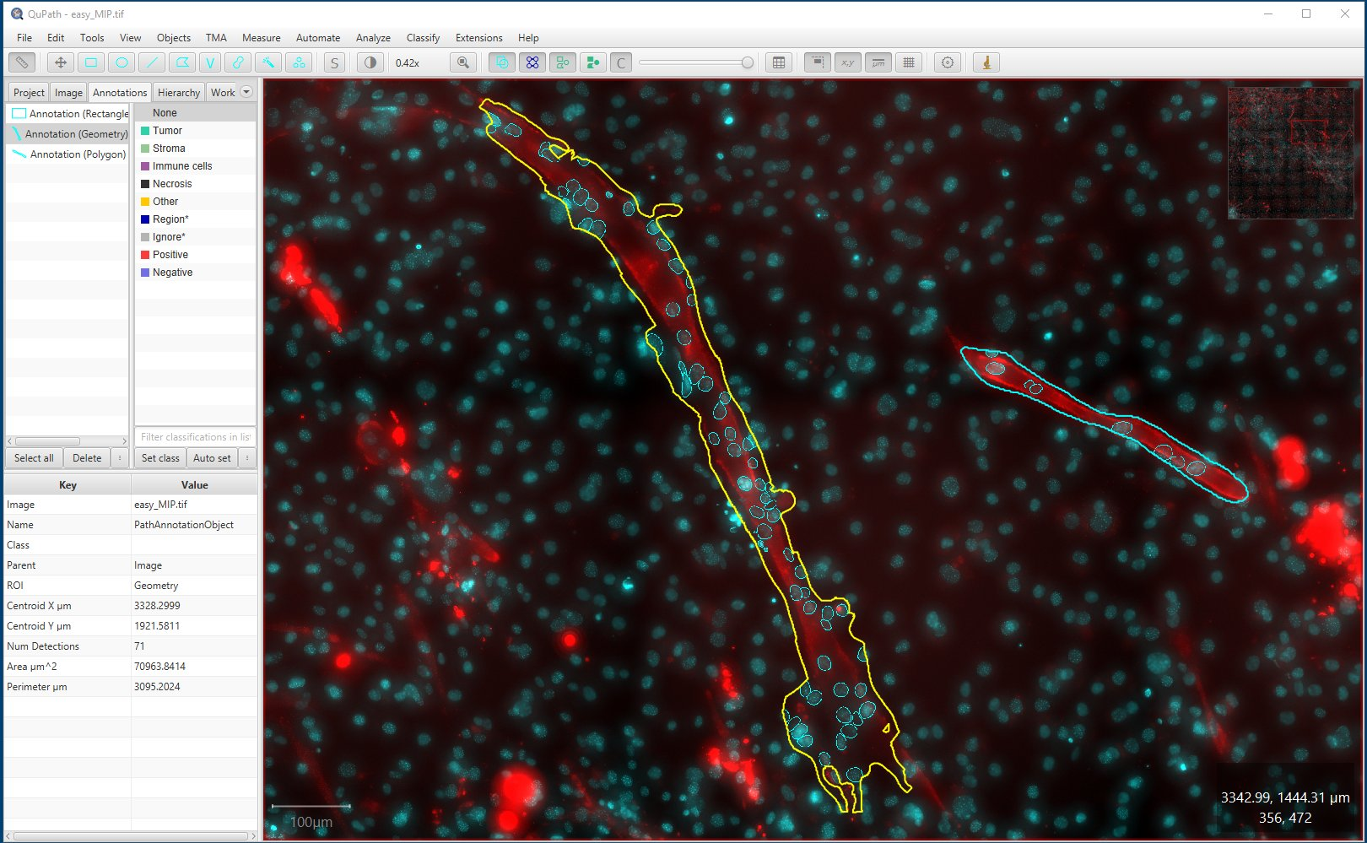
Cell/particle counting in QuPath
Nuclei segmented with StarDist
Image courtesy of Yakshi Dabas, David Allis Lab
Bio-Imaging Resource Center, The Rockefeller University

Slide 28
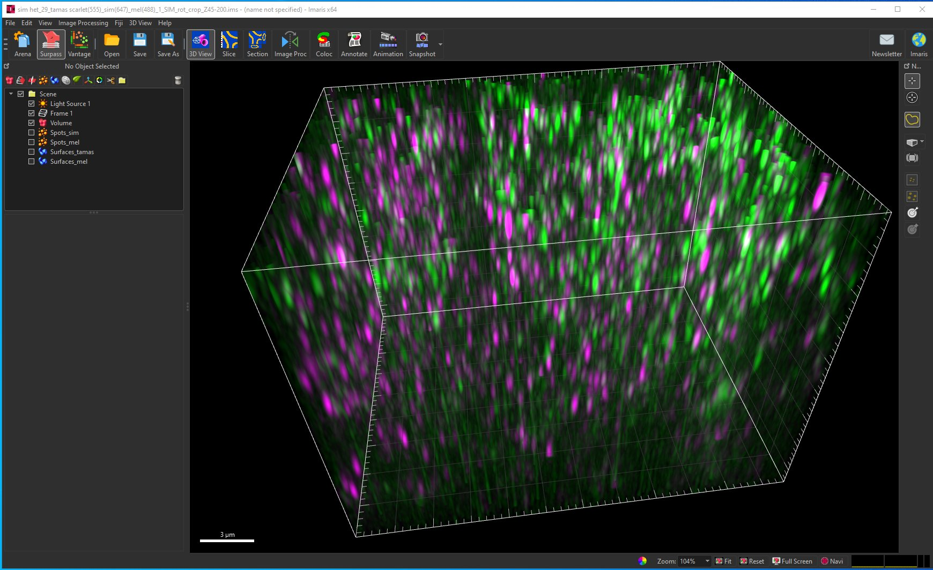
Cell/particle counting in 3D using Imaris
3D volume rendering showing green and magenta particles
Image courtesy of Toby Lieber, Agnel Sfeir Lab, MSKCC
Bio-Imaging Resource Center, The Rockefeller University

Slide 29
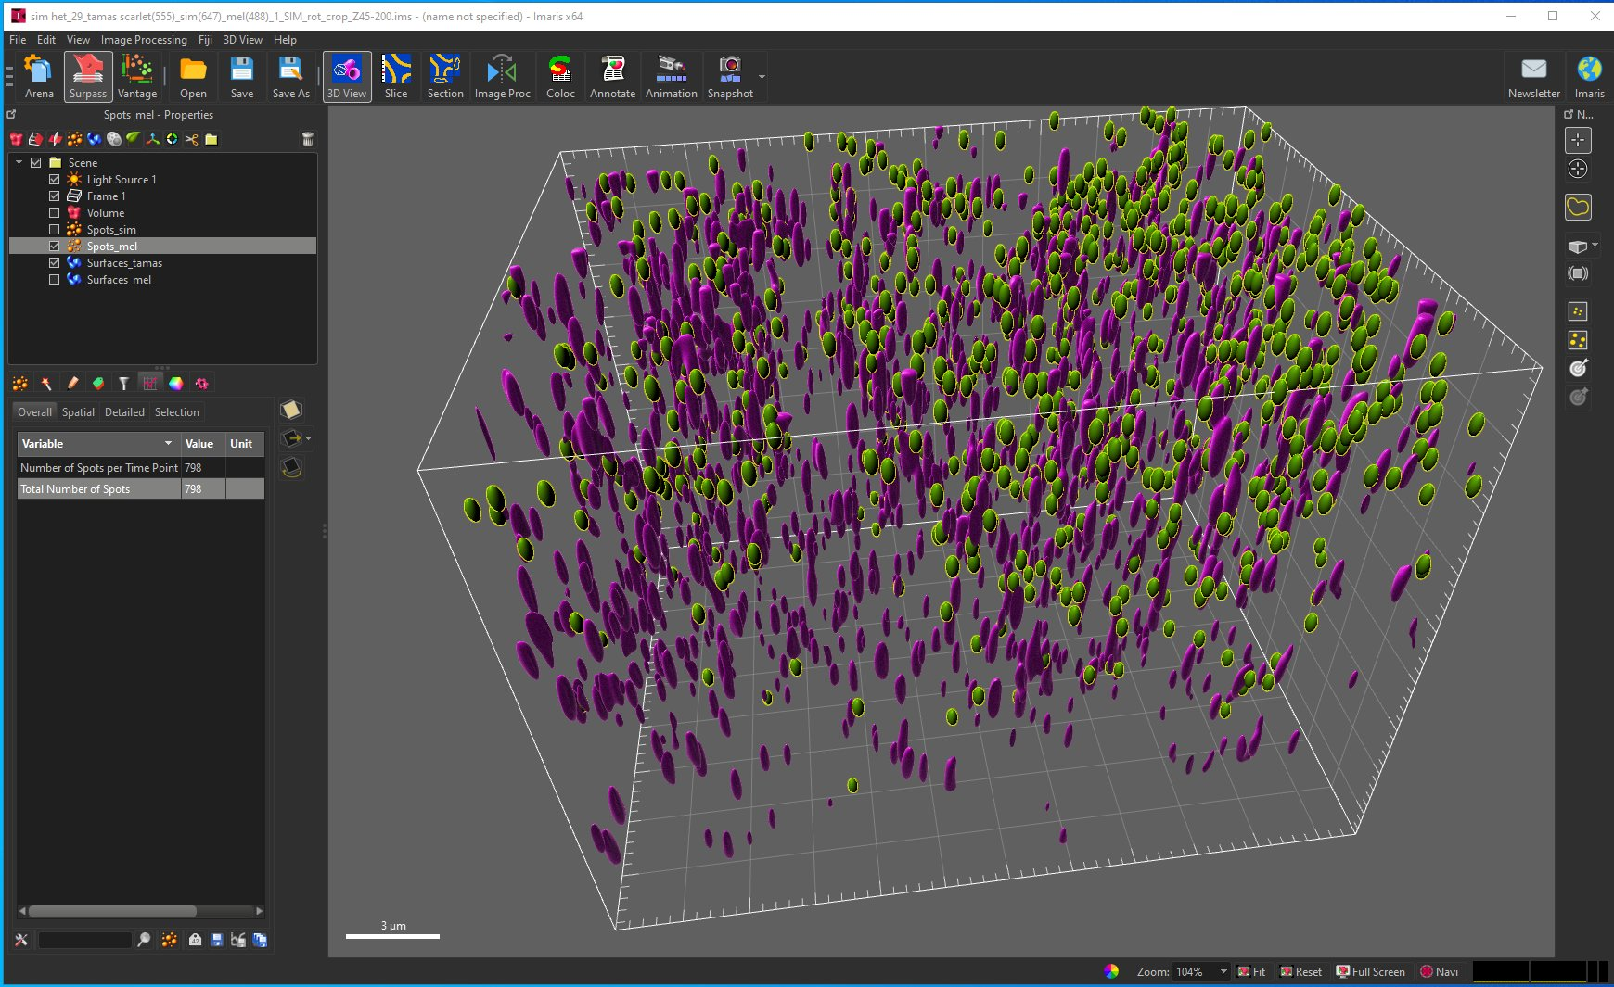
Cell/particle counting in 3D using Imaris
3D volume rendering showing green and magenta particles segmented and quantified
Image courtesy of Toby Lieber, Agnel Sfeir Lab, MSKCC
Bio-Imaging Resource Center, The Rockefeller University

Slide 30
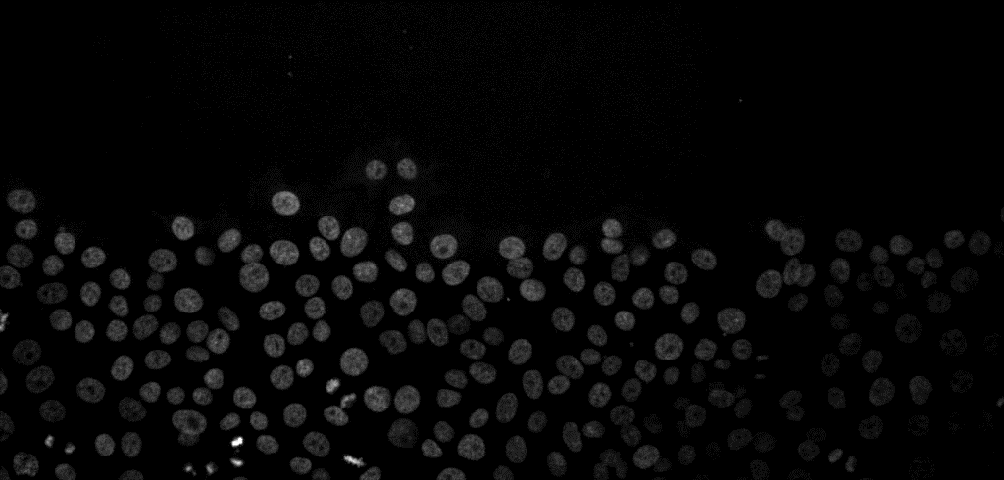
Cell/particle tracking in Fiji
Cancer cell migration
https://doi.org/10.5281/zenodo.5206107
Bio-Imaging Resource Center, The Rockefeller University
Notes:
Trackmate can also track in 3D

Slide 31
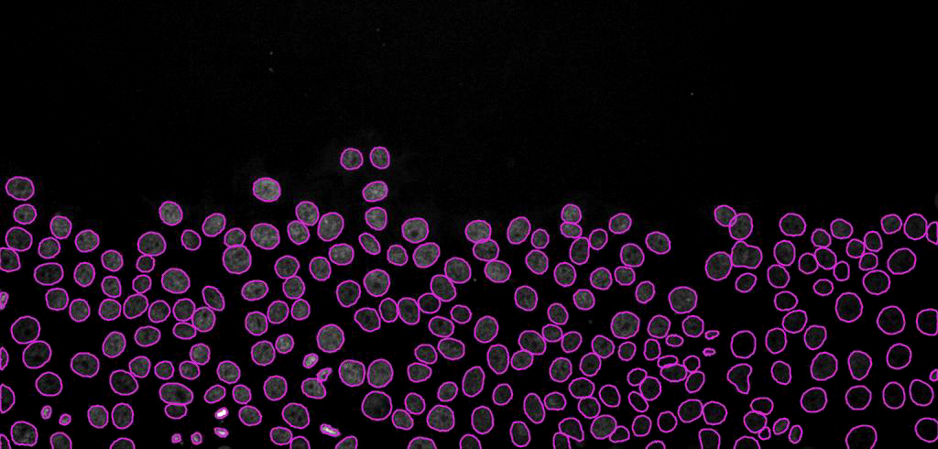
Cell/particle tracking in Fiji
StarDist based cell segmentation in TrackMate plugin
Bio-Imaging Resource Center, The Rockefeller University

Slide 32
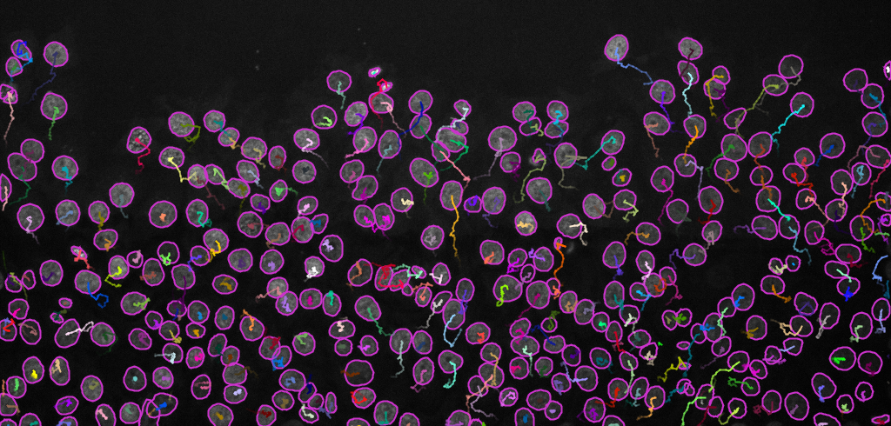
Cell/particle tracking - Fiji
Tracking results with the TrackMate plugin
3D tracking with TrackMate
3D tracking in Imaris
Workshop Exercise 2
Bio-Imaging Resource Center, The Rockefeller University

Slide 33
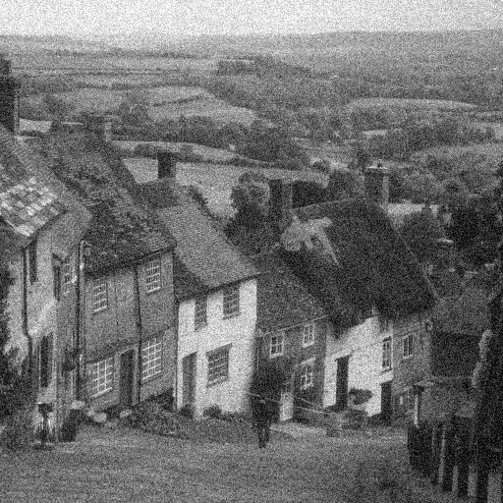

Denoising
The task of removing noise from an image
Not used solely for making an image look “good”, but when done properly, it can greatly improve the segmentation accuracy
Beware - denoising changes pixel values in the image!
denoising
Gold Hill, Shaftesbury, UK
Why acquire noisy images in the first place?
Low protein expression
High protein expression has unwanted phenotype
Photobleaching
Detection noise due to inherent uncertainly of photon detection
Bio-Imaging Resource Center, The Rockefeller University
Notes:
Shot noise, read noise, dark noise

Slide 34
Denoising - tools
Classical Filters – Gaussian, Median, Non-local means
Deep Learning methods (open-source): CARE, Noise2Noise, Noise2Void
Deep Learning methods (commercial): RCAN in Aivia
Bio-Imaging Resource Center, The Rockefeller University

Slide 35
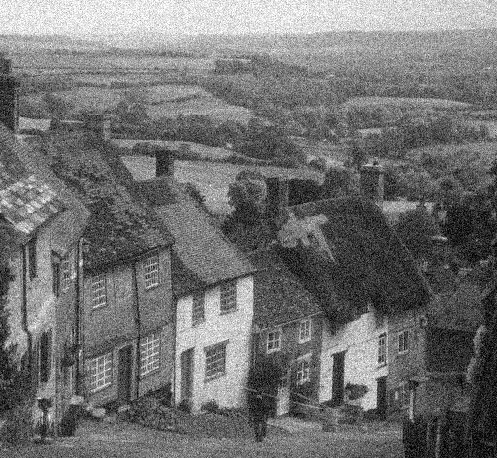



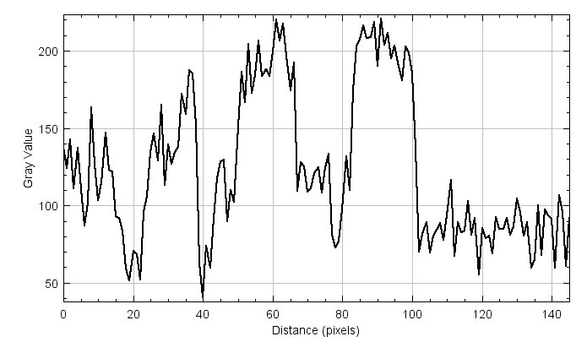
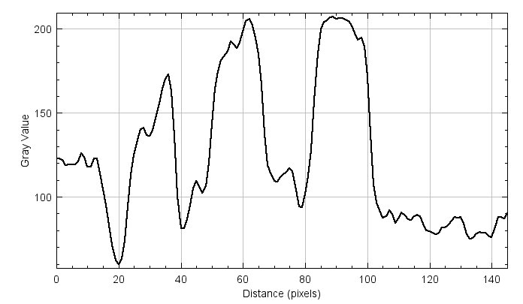
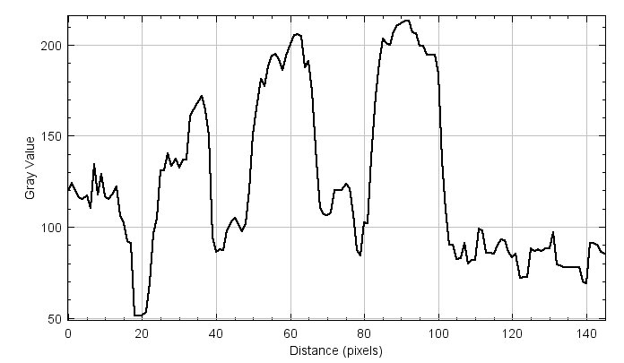
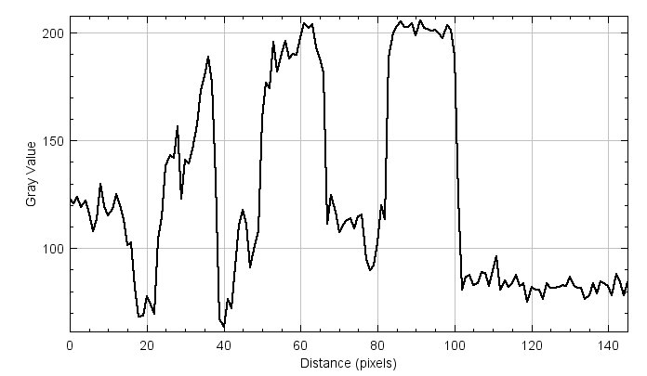
Denoising using image processing filters
Noisy image
Gaussian filter
Median filter
Non-local means filter
Bio-Imaging Resource Center, The Rockefeller University

Slide 36
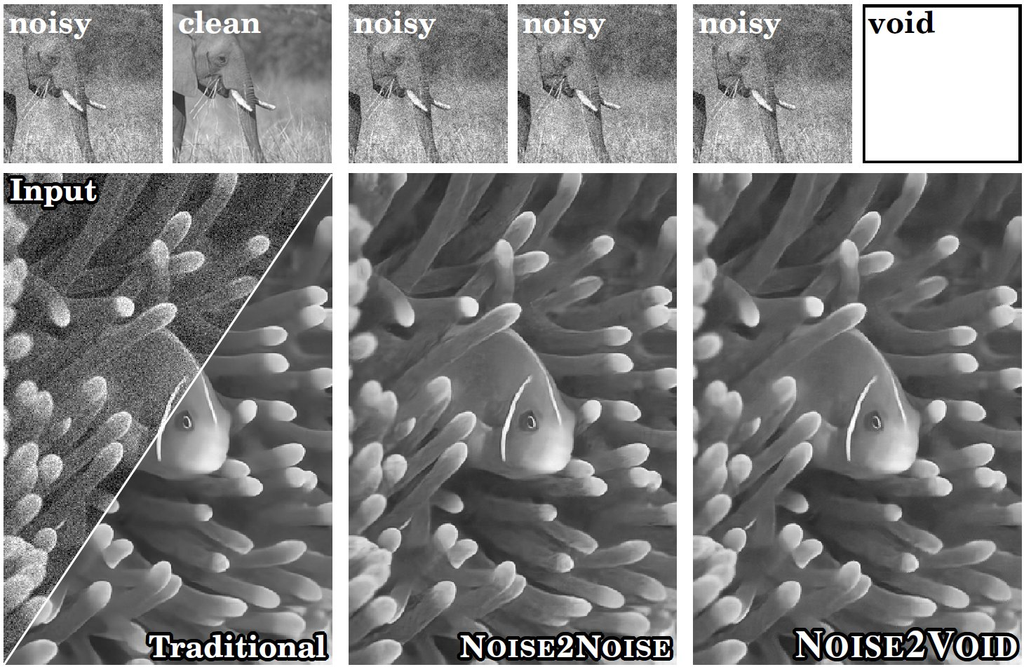
Denoising using Deep Learning methods (open-source)
Traditional (e.g. CARE)
Noise2Noise
Noise2Void
CARE (Content Aware Restoration):
A pair of high and low SNR images required for training the model
Noise2Noise:
A pair of noisy images required for training the model
Noise2Void:
Single noisy images are enough for training the model
Krull et al. https://doi.org/10.48550/arXiv.1811.10980
Bio-Imaging Resource Center, The Rockefeller University

Slide 37
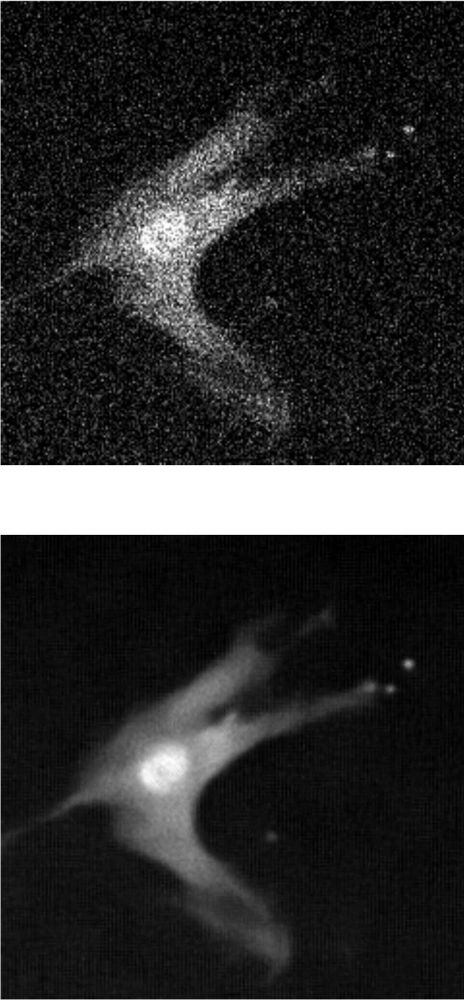
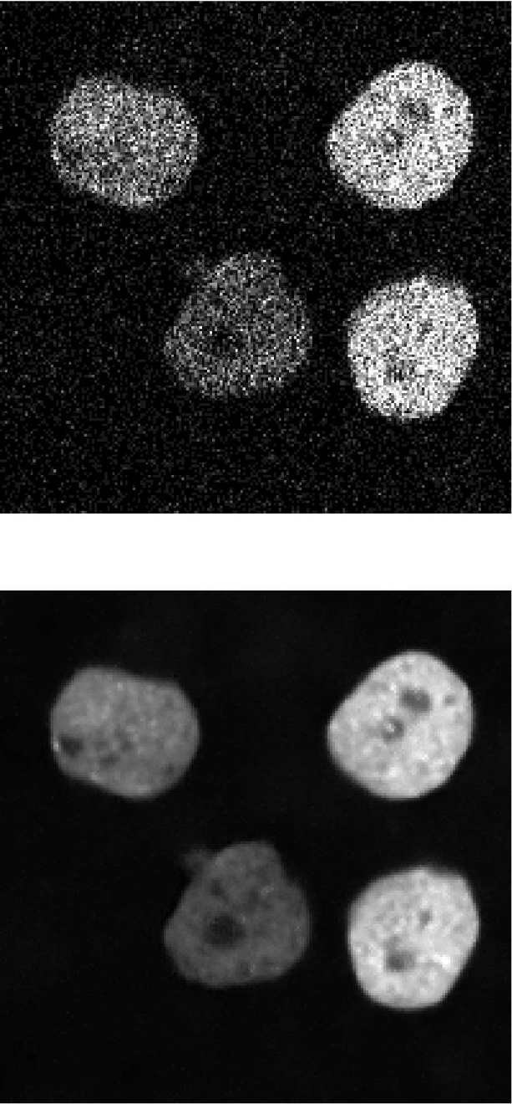
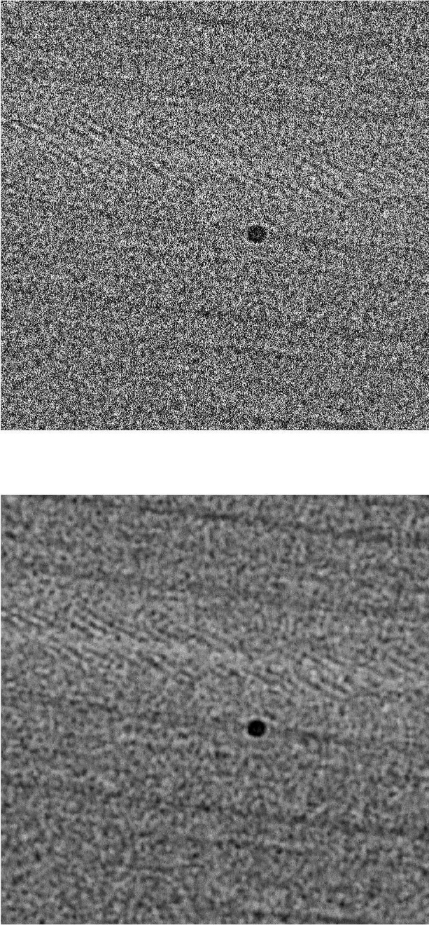
Denoising using Noise2Void
Cell (fluorescence)
Nuclei (fluorescence)
Cryo-TEM
Input image
Workshop Exercise 3
Noise2Void
Krull et al.
https://doi.org/10.48550/arXiv.1811.10980
Bio-Imaging Resource Center, The Rockefeller University

Slide 38
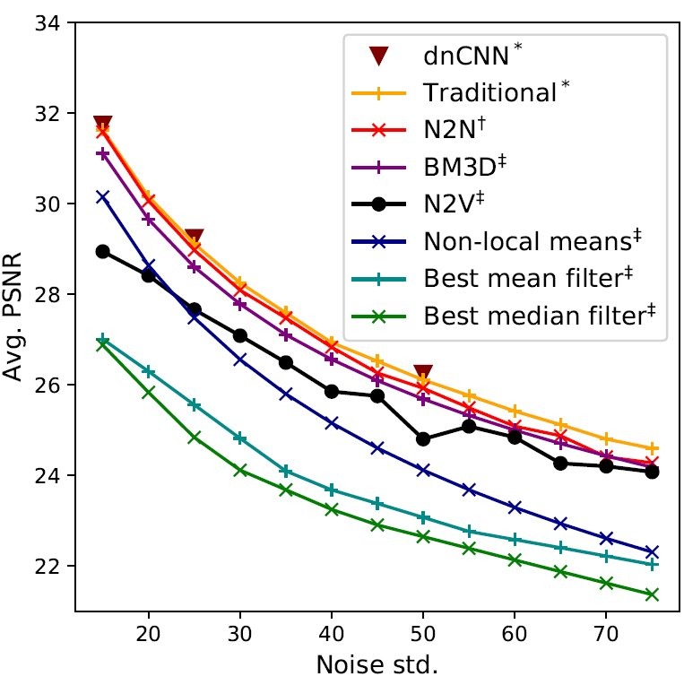
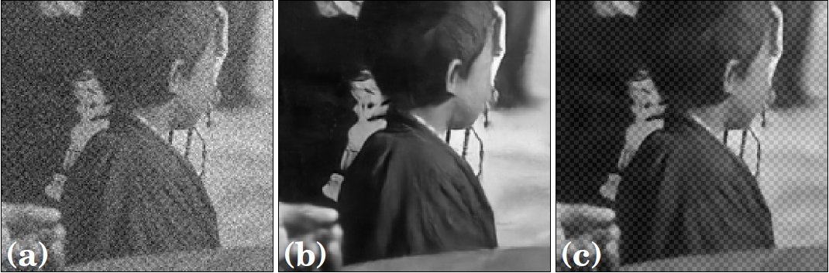
Denoising – limits of Noise2Void
Input image
Traditional (e.g. CARE)
Noise2Void
N2V cannot distinguish between the signal and structured noise that violates the assumption of pixel-wise independence of noise
N2V can not be expected to outperform methods that have additional information during training (CARE, N2N)
Krull et al. https://doi.org/10.48550/arXiv.1811.10980
Bio-Imaging Resource Center, The Rockefeller University

Slide 39
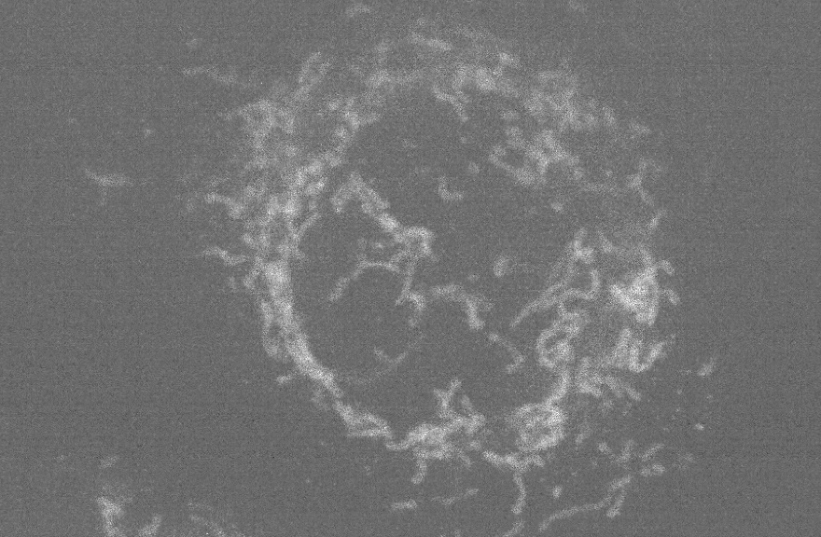
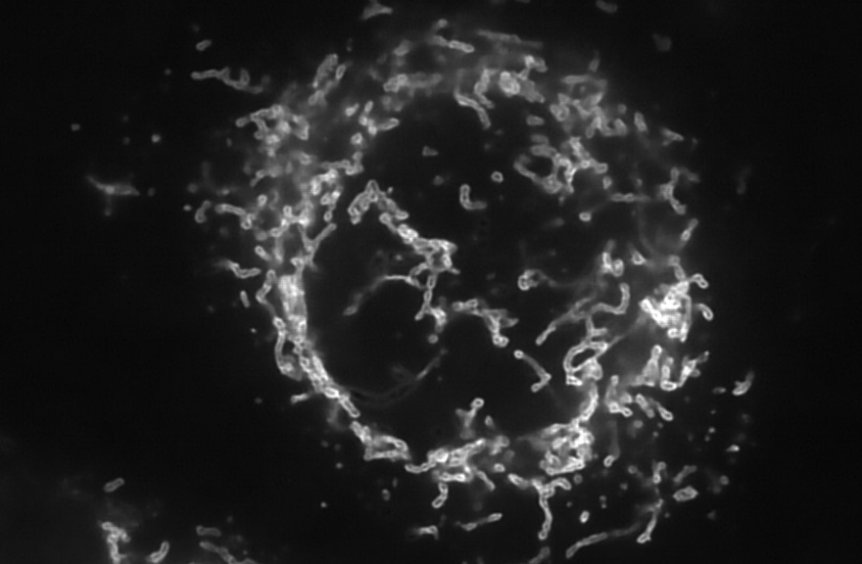
Denoising using Deep Learning methods (commercial: Aivia)
Aivia Deep Learning Models
Denoising_Actin_iSIM-60x
Denoising_ER_iSIM-60x
Denoising_Generic(mito+MT)_iSIM-60x
Denoising_Golgi_iSIM-60x
Denoising_Lysosome_iSIM-60x
Denoising_Microtubule_iSIM-60x
Denoising_Mitochondria_iSIM-60x
Expansion_Microtubule+decon
Expansion_Mitochondria+decon
Restoration
Segmentation
Segmentation_3D_EM_ISBI_2013
Segmentation_3D_EM_UW_WongLab
Virtual_Staining_Actin_20x
Virtual_Staining_Microtubule_20x
Virtual_Staining_Nucleus_20x
Original image
Mitochondria membrane captured on an iSIM
Model trained on RCAN architecture from Hari Shroff lab (NIBIB, NIH)
Chen et al. Nat. Methods 2021
Denoised image
Images from https://www.aivia-software.com
Bio-Imaging Resource Center, The Rockefeller University

Slide 40
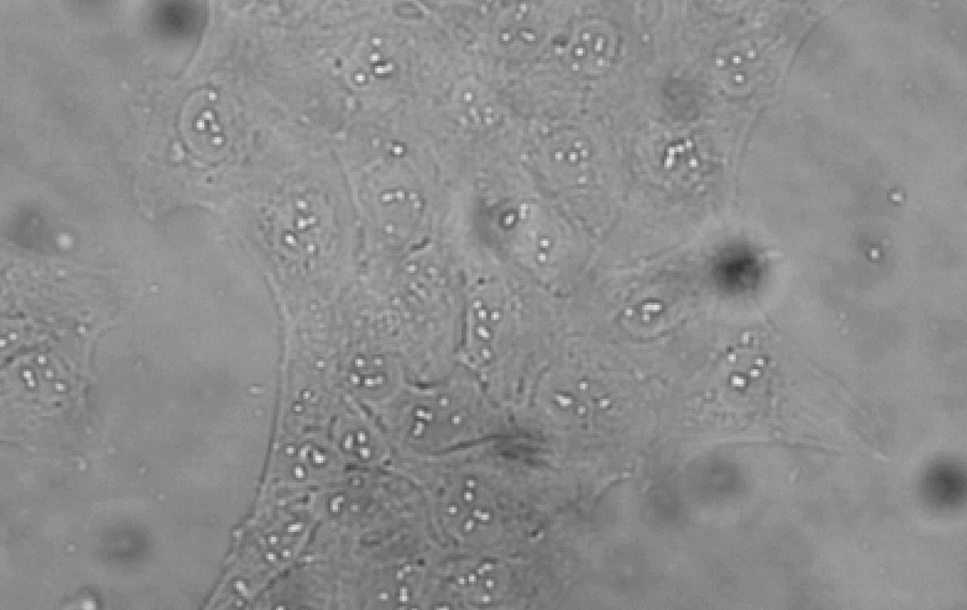
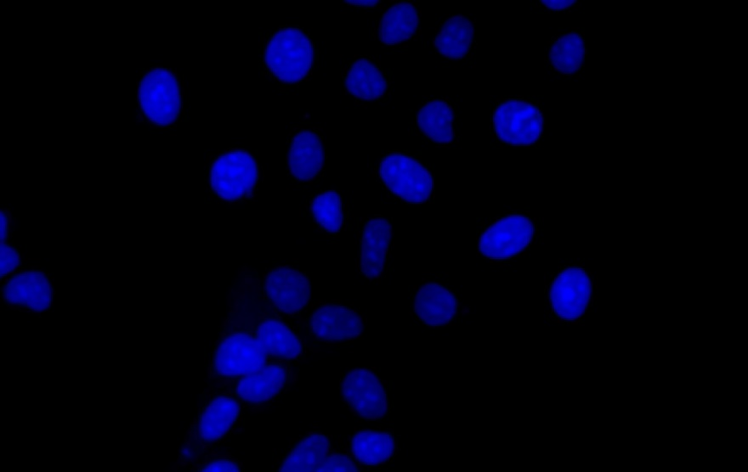
Virtual staining using Aivia
Aivia Deep Learning Models
Denoising_Actin_iSIM-60x
Denoising_ER_iSIM-60x
Denoising_Generic(mito+MT)_iSIM-60x
Denoising_Golgi_iSIM-60x
Denoising_Lysosome_iSIM-60x
Denoising_Microtubule_iSIM-60x
Denoising_Mitochondria_iSIM-60x
Expansion_Microtubule+decon
Expansion_Mitochondria+decon
Restoration
Segmentation
Segmentation_3D_EM_ISBI_2013
Segmentation_3D_EM_UW_WongLab
Virtual_Staining_Actin_20x
Virtual_Staining_Microtubule_20x
Virtual_Staining_Nucleus_20x
Original image
Brightfield image (DIC, 20x)
Model trained on RCA U-Net architecture
Predicted image
Fluorescence image (simulates DAPI)
Images from https://www.aivia-software.com
Bio-Imaging Resource Center, The Rockefeller University

Slide 41
Image analysis help at BIRC
Help users analyze their data
Suggestion on the best method/software/pipeline for user data analysis
Open-source: Fiji, QuPath, ilastik, DeepImageJ, ZeroCostDL4Mic, Napari, CellProfiler
Imaris – 2D/3D large data, segmentation, counting, tracking; currently lacks deep learning methods
Arivis – Light-sheet data (multi-GB to TB)
Aivia – AI-powered 3D image analysis (e.g. segmentation, denoising )
Huygens – deconvolution, 2D/3D chromatic aberration correction
Writing customized image analysis scripts, pipelines, batch processing
Experimental design discussion with a team of microscopy and image analysis staff, to ensure that the imaging data acquired will be appropriate for the planned analysis and research questions
Bio-Imaging Resource Center, The Rockefeller University

Slide 42
Training
One-on-one Image analysis training
Regular workshops on image analysis
basic ImageJ/Fiji workshop
advanced ImageJ/Fiji workshop
commercial analysis softwares – Imaris, Arivis, Huygens, Aivia
Colocalization and distance analysis
New tools for Methods reporting in manuscripts – MethodsJ2
Handling big data – BigDataViewer in Fiji, Imaris, Arivis
Data management and figure generation in OMERO
May 4th – Jason Swedlow, OME
“Image Analysis User Group” – NEW!!!
- anybody who is interested in image analysis discussion
- Regular meetings in an informal setting where members will take turn presenting on a specific topic
- new method/pipeline/software/paper
- First meeting in May 2022
- Contact vsharma01@rockefeller.edu to join the group
Helpdesk session: 3-5 pm every Wednesday
Bio-Imaging Resource Center, The Rockefeller University

Slide 43
Acknowledgements
Bio-Imaging Resource Center Team
Alison North
Christina Prygaki
Priyam Banerjee
Bridget Biersmith
Ved Sharma
Tao Tong
Alison North
Thomas Carroll
James Hudspeth
Funding from the Beckman Foundation for Advanced Light-Sheet Microscopy and Data Science
our users!
Bio-Imaging Resource Center, The Rockefeller University

